Slide 1

AMCS1003 Software engineering
Group 4 : Logistics System
By Tan Kang Hong, Lau Jun Dian, Har Chun Wai,
Cheng Cai Jie & Nee Mei Yi

Slide 2

CEO
Har Chun Wai
CFO
Lau Jun Dian
Graphic Designer
Nee Mei Yi
Programmer
Tan Kang Hong
Marketing Manager
Cheng Cai Jie

Slide 3

PART 2

Slide 4
Table of contents Part 2 2.1Project Plan and Schedule 2.2 Software Requirement Specification 2.2.2 Non-Functional requirements 2.3.1 Activity Diagram 2.3.2 Use Case Diagram

Slide 5

2.1 Project Plan and Schedule

Slide 6
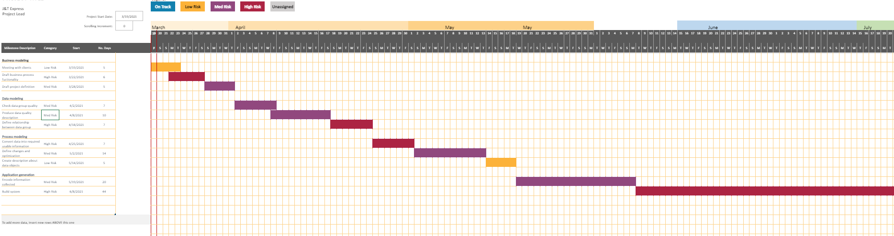
Gantt chart
Task Allocation list and Gantt Chart are available in Excel File:
https://onedrive.live.com/view.aspx?resid=3074BFCAF65A538B!11798&ithint=file%2cxlsx&authkey=!AJFGhS7gZlP4MK8

Slide 7
TASK |  | Start Date | No. Days
Business modeling | Meeting with clients Draft business process fuctionality Draft project definition | 26-March-2021 29-March-2021 04-April-2021 | 5 6 5
Data modeling | Check data group quality Produce data quality description Define relationship between data group | 09-April-2021 15-April-2021 25-April-2021 | 7 10 7
Process modeling | Convert data into required usable information Define changes and optimization Create description about data objects | 02-May-2021 09-May-2021 21-May-2021 | 7 14 5
Application generation | Encode information collected Build system | 26-May-2021 15-July-2021 | 20 44

Slide 8
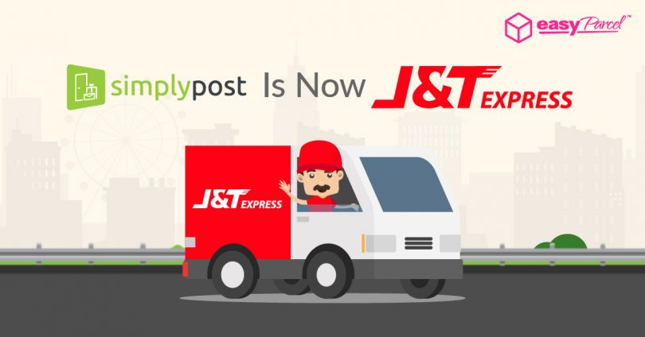
2.2 Software Requirement Specification
Functional requirements
Non-Functional requirements

Slide 9
Functional requirements
Customer
Administrator

Slide 10
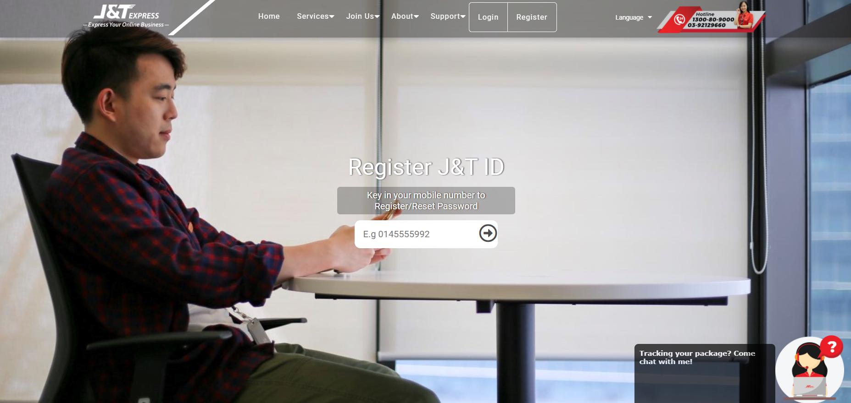
Customer
Enable access to member-only contents
The register screen which needs customer to input the phone number

Slide 11
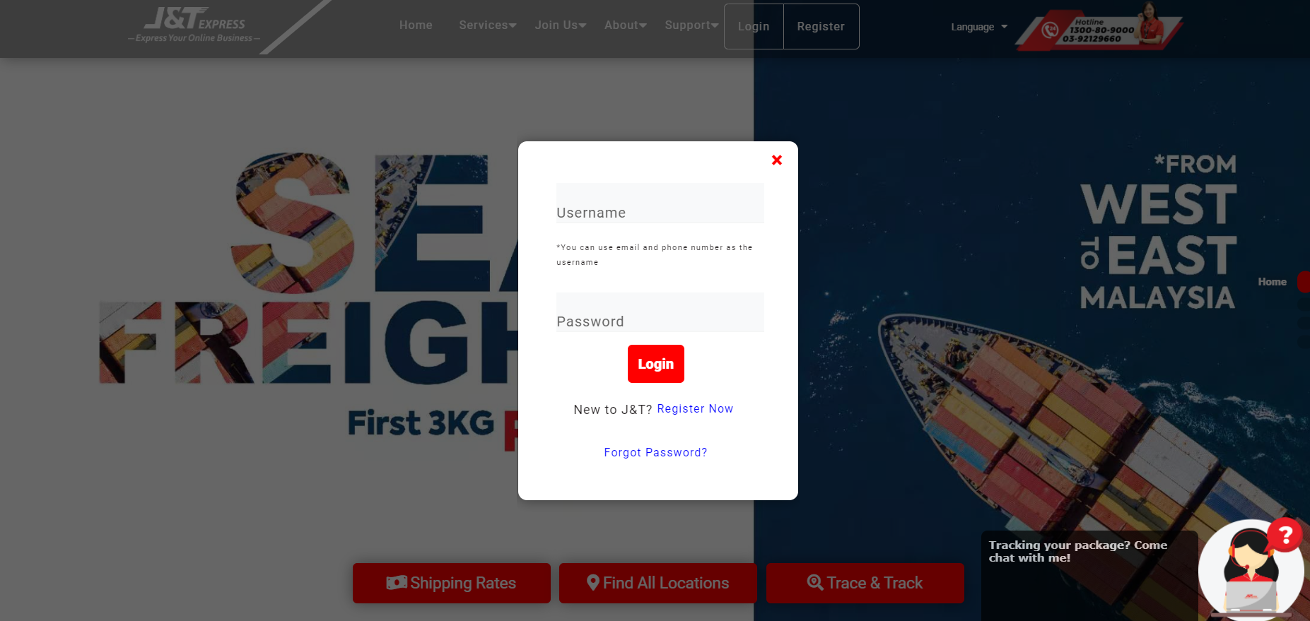
Customer
2.Access login or register
Login screen

Slide 12
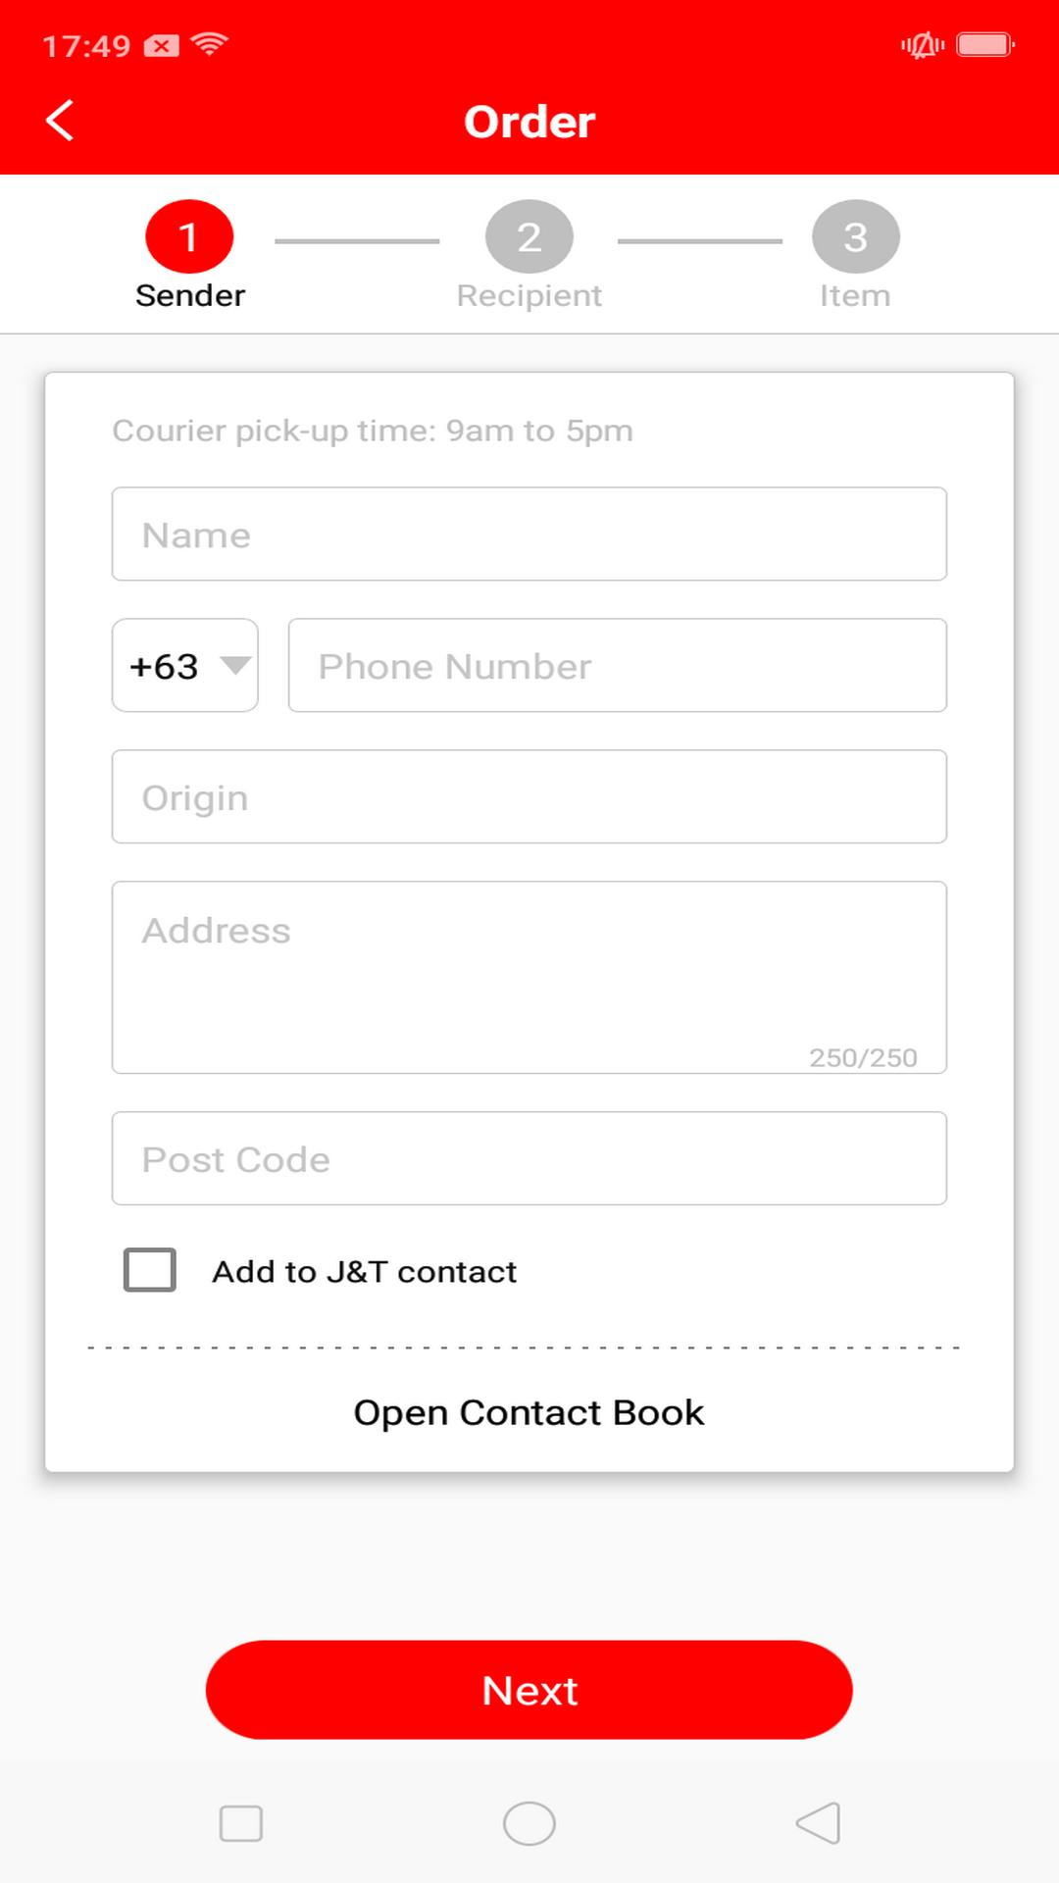
Customer
Display order page
A create order screen in the mobile app

Slide 13
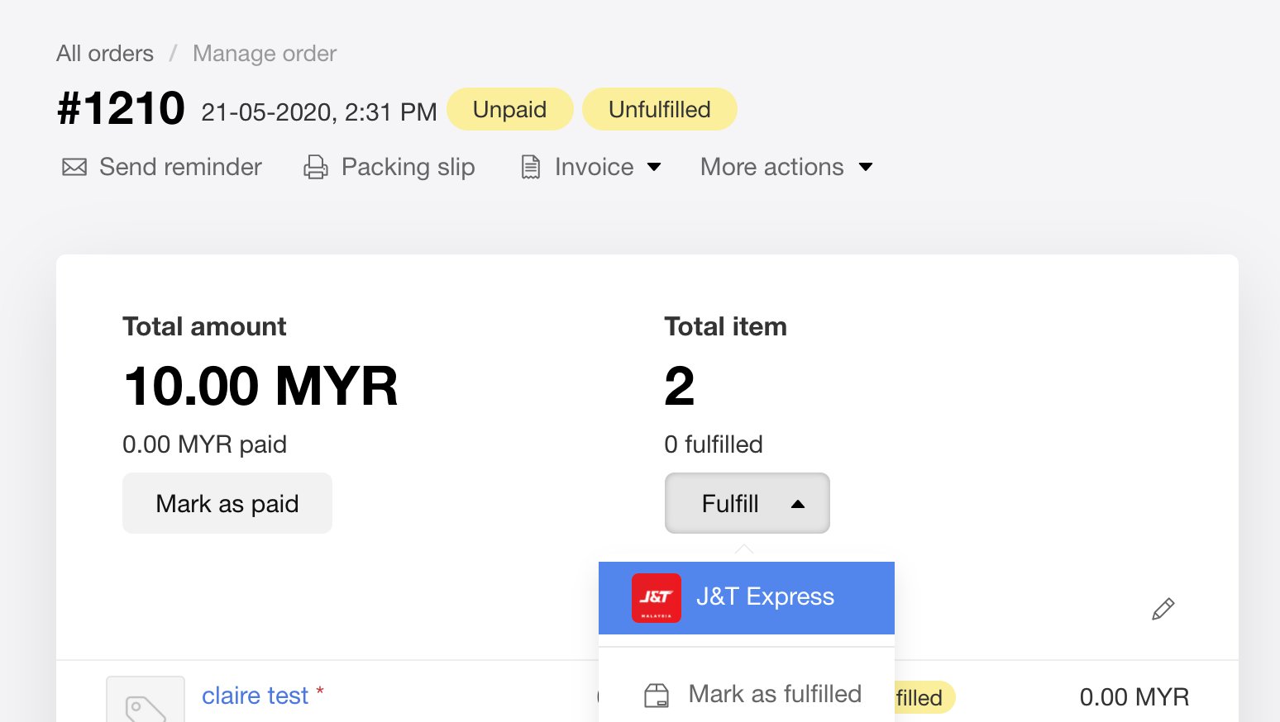
Customer
Display the order details and payment.
An order payment screen on the website

Slide 14
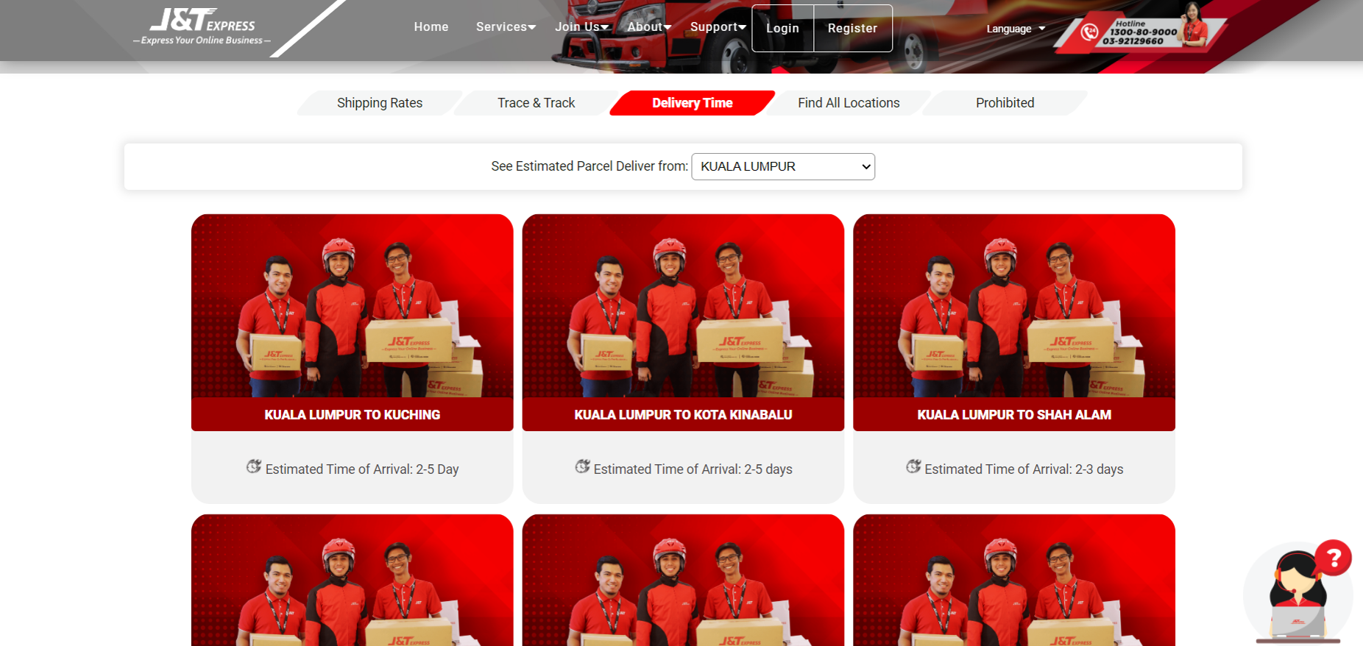
Customer
Send verification email.
Generate a receipt.
Enable check the estimated delivery time
The screen of the estimated delivery time from Kuala Lumpur

Slide 15
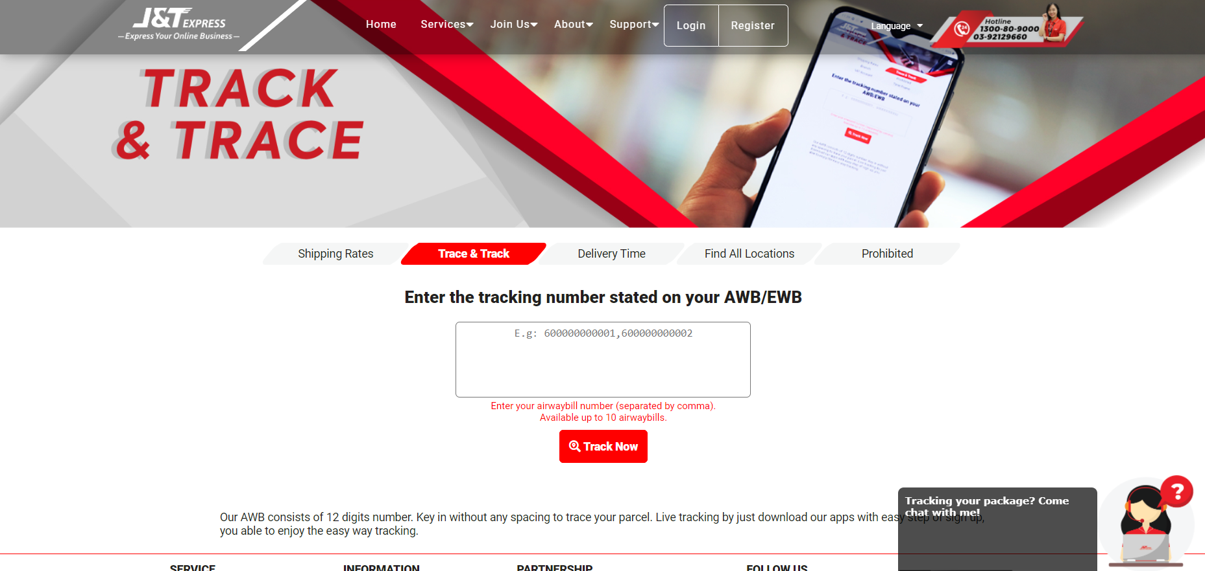
Customer
Trace and Track
Parcel reminder
Trace and Track screen

Slide 16
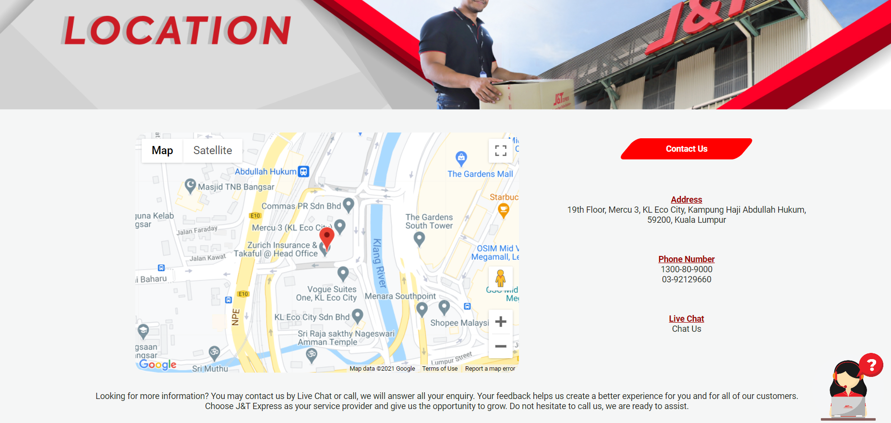
Customer
Feedback from customer
The “Contact Us” page allowing customers to know where to contact the J&T Express service

Slide 17
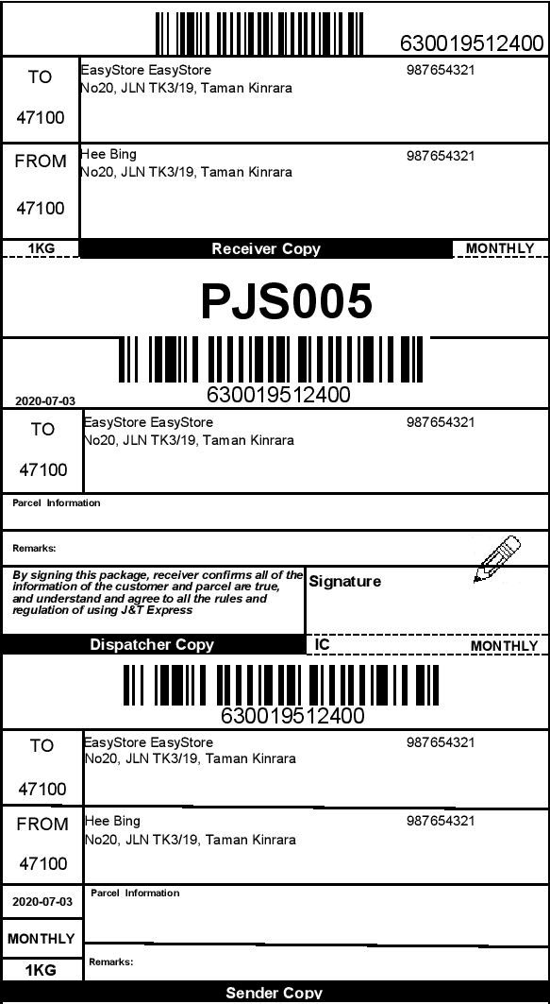
Administrator
Confirmation of the customer’s order
The order payment screen

Slide 18

Administrator
12 . Payment history.
13. Reconfirm the ordering order.
14. Arrange order by places.
15. Collection of customer feedback.

Slide 19
2.2.2 Non-Functional requirements

Slide 20
Reliability Requirements
Scalability Requirement
Maintainability Requirement
Usability Requirement
Error-handling Requirement
Security Requirement

Slide 21
Performance Requirement.
Accuracy Requirements
Concurrency Requirement
Portability Requirement
Data integrity Requirement.
Interoperability Requirement
Capacity Requirement
Accessibility Requirements
Recoverability Requirements

Slide 22
2.3.1 Activity Diagram

Slide 23
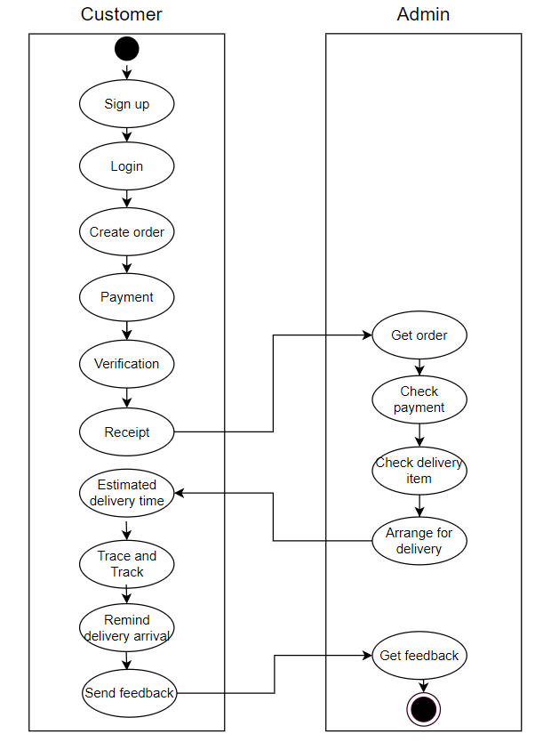

Slide 24

2.3.2 Use Case Diagram

Slide 25
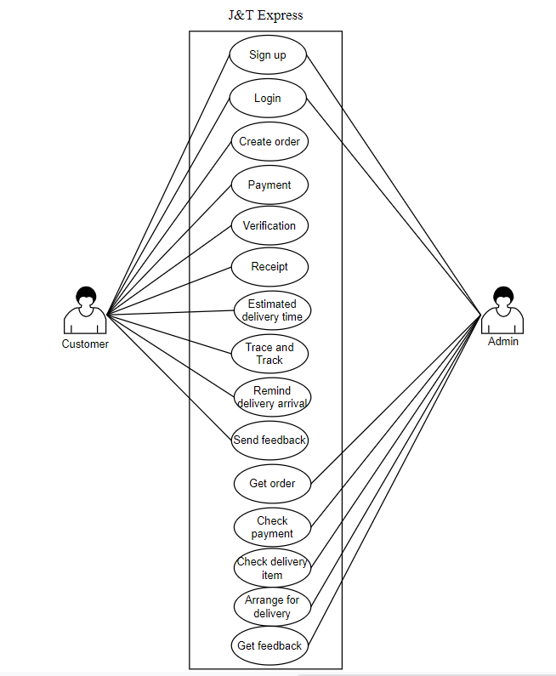

Slide 26

The end
Thank for listening

